Slide 1
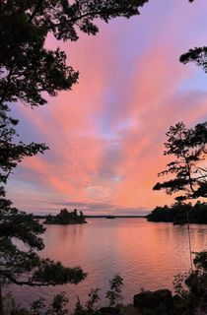
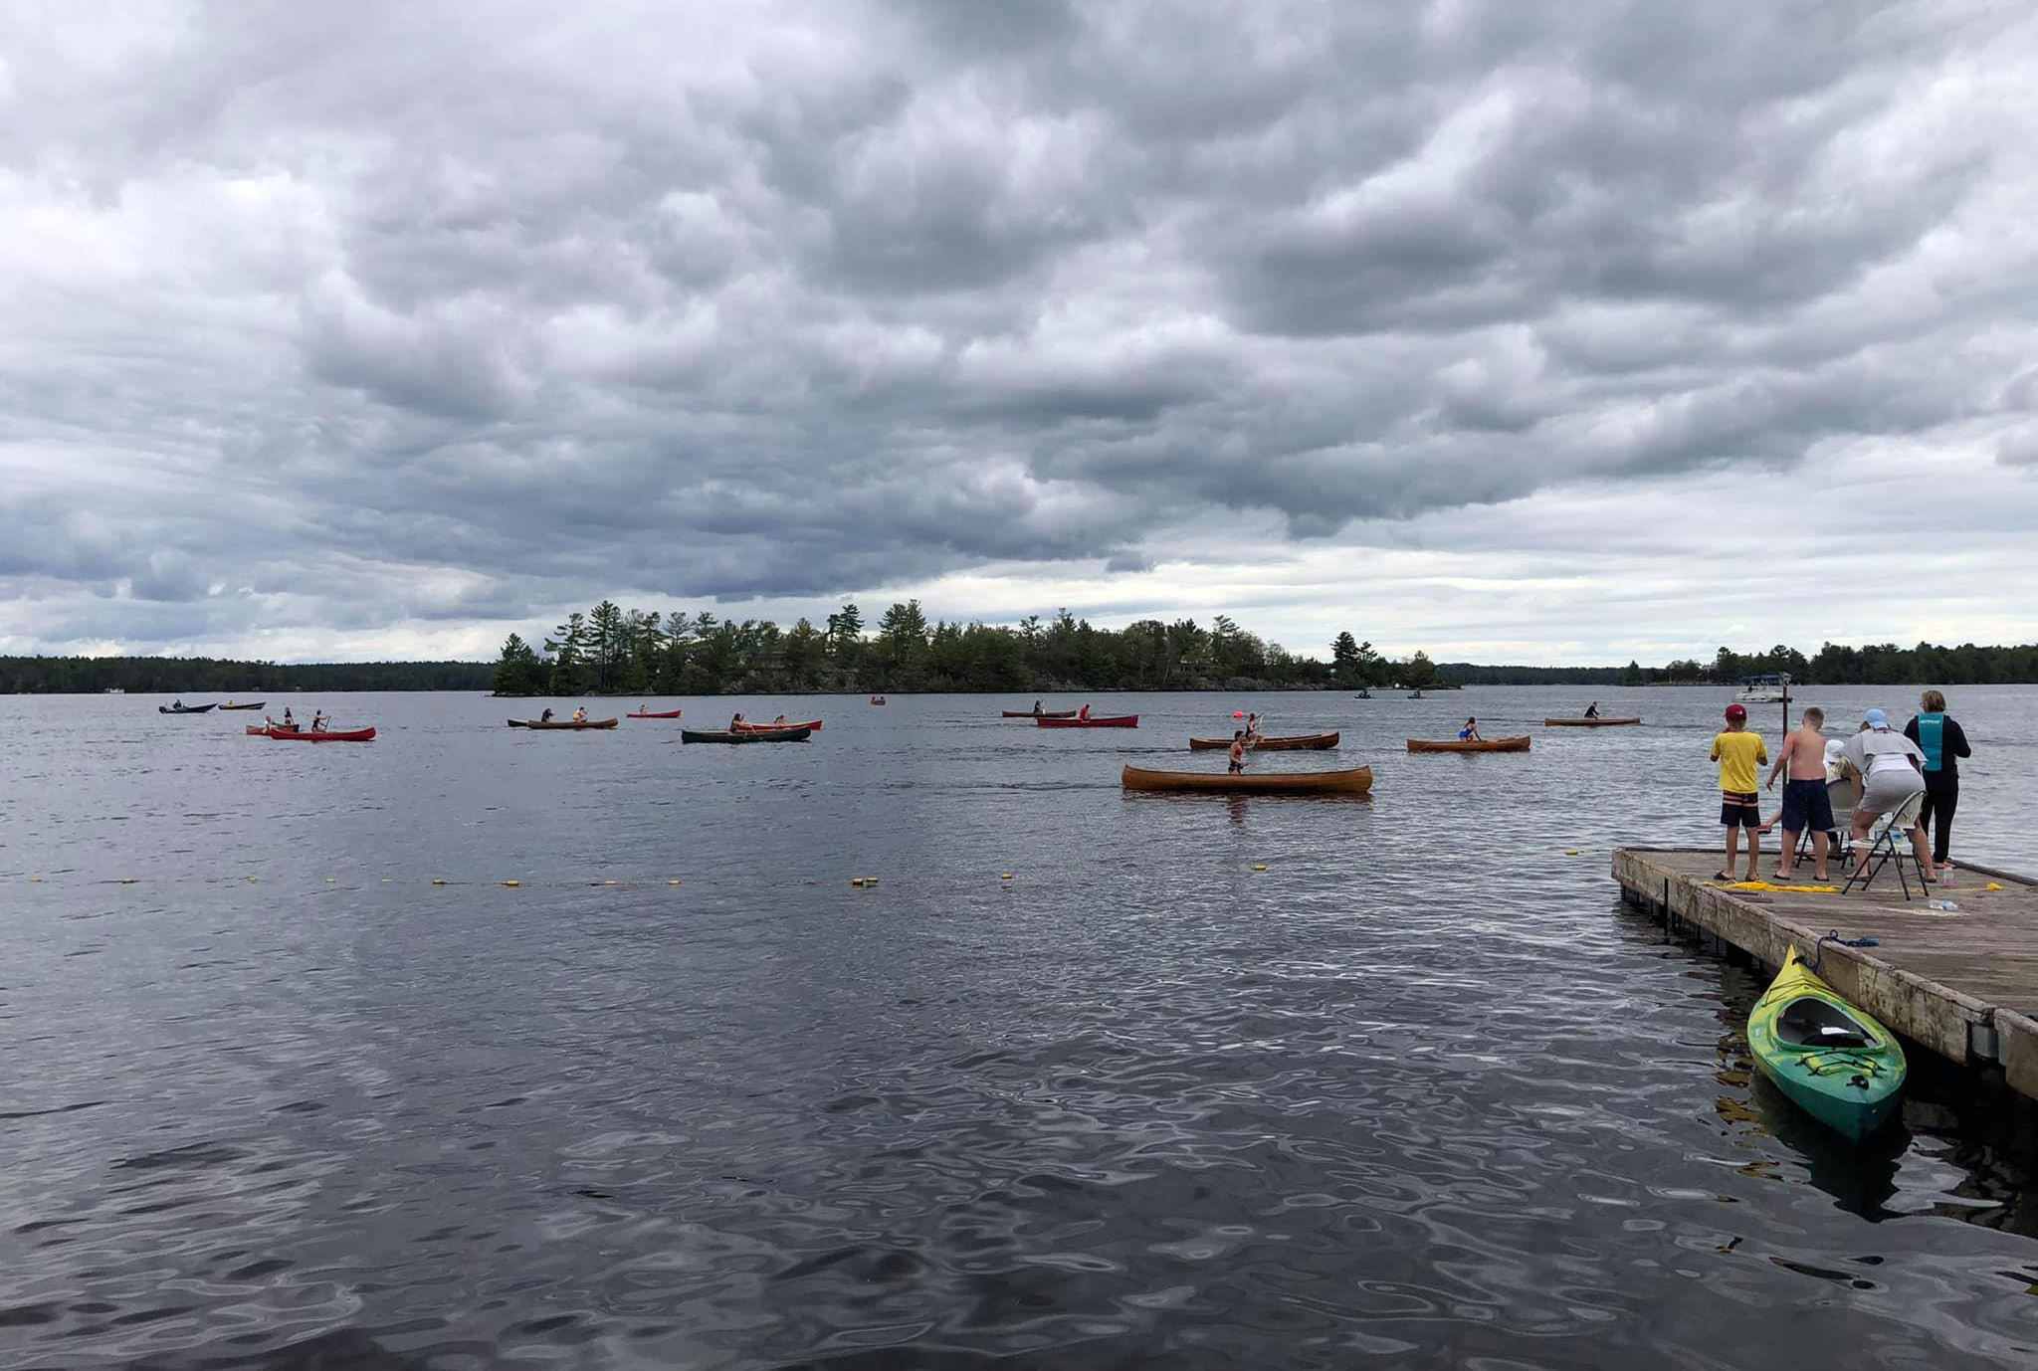
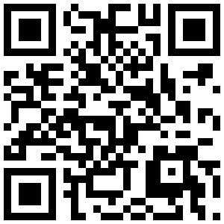
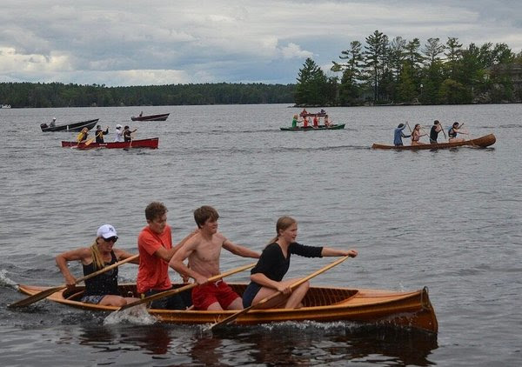
Dear fellow Stoney Lake residents and visitors,
The Upper Stoney Lake Association is a group of residents who work to foster community, and advocate for the interests of Stoney Lakers.
Our dedicated volunteers plan and organize the yearly USLA Regatta, Art Show, dances, Fishing Derby, Stoney Lake Paddle, book club, fitness classes, volleyball, youth activities, and other social events, which create lasting Stoney Lake memories for all.
We are your advocates and voice to local government. We monitor water quality testing, fish, weed, and wildlife studies, coordinate the marking of rocks and shoals, maintain and operate the USLA Pavilion, and work hard to keep you up to date. We do this through our website, newsletters, email blasts, social media, Annual General Meeting, and one-on-one contact.
To keep things running we require financial support from the residents in the form of a membership fee for each family (including children up to 25). We hope that you will take the time to show your support with your membership. For current rates, scan the QR code, or go to www.usla.ca and click Join, or email us. One time donations are also greatly appreciated.
Thank you in advance for your support,
Your USLA volunteer executive
USLA MEMBERSHIP FORM
Pay your membership fee, or donation in several ways:
Use the QR, or go to www.usla.ca and log in or click Join at the bottom of the homepage, and use your credit card at check out
Or, send an e-transfer using the email address membership@usla.ca, then go to www.usla.ca and log in or click Join at the bottom of the home page
Or, send this completed form and a cheque payable to USLA, to 2365 Crowe’s Landing Rd., Douro-Dummer, ON K0L 2H0
(One time donations can similarly be made by credit card, e-transfer to donations@usla.ca, or by check)
Name _________________________________________
Spouse Name ___________________________________
Children _______________________________________
Property No.____ St. or Fire Rt. ____________________
Cottage Name _______________ Island Number ______
Township Douro-Dummer ☐ North Kawartha ☐
Home Address __________________________________
City ____________Prov/State ___Postal/Zip Code _____
Email Address __________________________________
Preferred Phone ________Phone(for Directory) _______
Include me in the Membership Directory? Y☐ N☐
THANK YOU!!

Slide 2
Join the USLA today!!!!
www.usla.ca

